Slide 1
Product Review Sentiment Analyzer
Group Project No. 3

Slide 2
MENTOR & TEAM MEMBERS
Mentors:
Abhisheka Kavuri
Kartik
Team Members:
Leena Prakash Chaudhari
Anil
Aditi Akshay Sawant
Kasadi Sai Teja
Srishakti.Awanti

Slide 3
Project Objectives:
To collect and preprocess customer reviews.
To convert text data into numerical format using TF-IDF.
To build a sentiment classification model using SVM.
To classify reviews into positive, neutral, and negative sentiments.
To develop a Streamlit application for real-time sentiment prediction and business insights.

Slide 4
DATASET DETAILS:
2704
Reviews / Observations Customer reviews collected from Amazon
2–3
Input Columns
80/20
Train/Test Split
3
Key Categories
Positive, Neutral, Negative sentiments
column | Type | Description
Title | Text | Short headline of the review
Body | Text | Full review given by customer
Rating | Integer(1-5) | Star rating provided
Review | Derived column | Combined text (title + body)
Sentiment | Target Label | Positive / Neutral / Negative

Slide 5
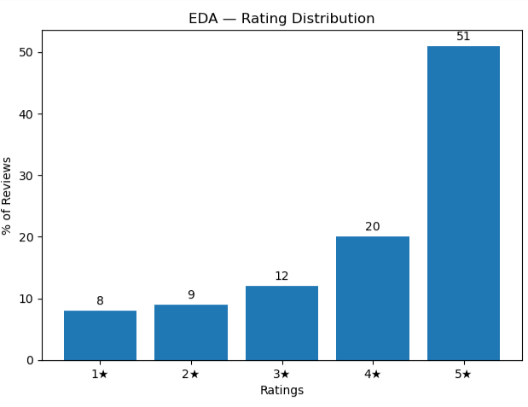
EDA-Rating Distribution:
KEY POINTS:
5★ reviews dominate, contributing around 51% of total reviews
Only 17% of reviews fall under 1★–2★ (negative class)
Dataset is imbalanced with a higher proportion of positive reviews
Average rating is approximately 4.1 / 5.0, indicating positive sentiment
Class imbalance should be considered during model evaluation

Slide 6
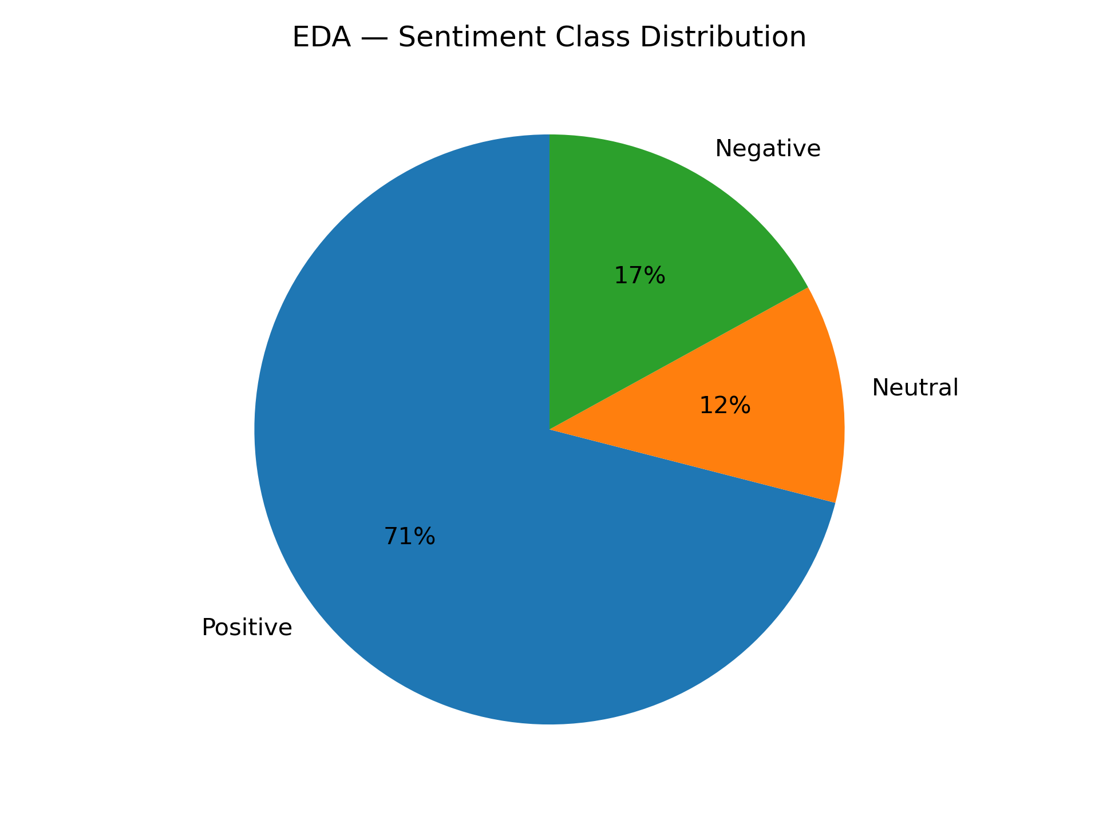
EDA-SENTIMENT DISTRIBUTION:
KEY POINTS:
Positive class dominates with around 71% of total reviews
Neutral class is the smallest (around 12%)
Negative class represents about 17% of reviews
Dataset shows strong class imbalance toward positive sentiment
Neutral class is harder to classify due to similarity with positive reviews
Evaluation metrics like F1-score and Recall are important due to imbalance

Slide 7
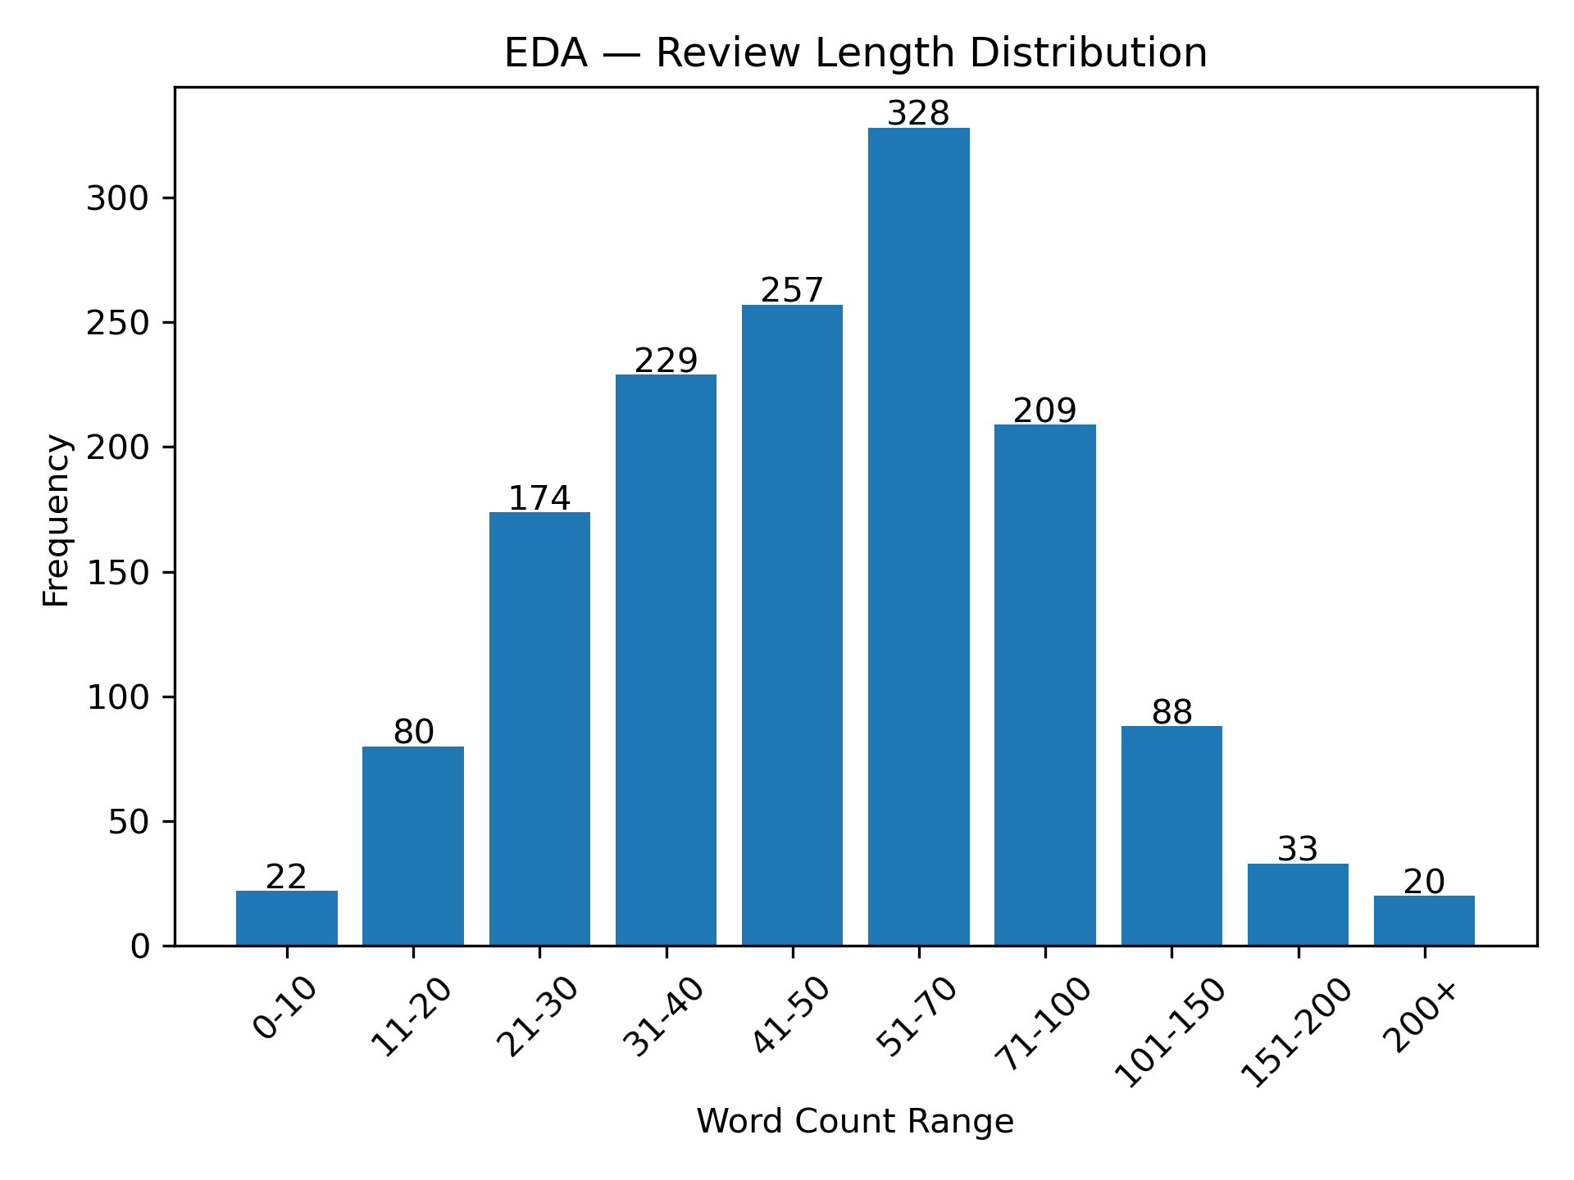
EDA-REVIEW LENGTH DISTRIBUTION:
KEY POINTS:
Majority of reviews fall in the shorter length range (0–50 words)
Very few reviews are extremely long (above 100 words)
Short reviews are quick opinions, while longer reviews provide detailed feedback
Extremely short reviews may lack meaningful sentiment information
Moderate-length reviews are most useful for accurate sentiment analysis
Controlling review length helps improve model performance

Slide 8
Text Preprocessing Pipeline
Converted text to lowercase for consistency
Removed special characters, punctuation, and emojis
Eliminated stopwords (e.g., is, the, and)
Applied tokenization to split text into words
Performed lemmatization for word normalization
Removed duplicate and irrelevant reviews
Converted cleaned text into numerical form using TF-IDF

Slide 9
FEATURE ENGINEERING:
Identified important words from customer reviews
Converted text data into numerical form using TF-IDF
Focused on word frequency and importance
Removed low-frequency and irrelevant words
Normalized text for consistency
Improved feature quality for model training
Enhanced sentiment prediction accuracy

Slide 10
Train-Test Split Strategy
Split dataset into training and testing sets
Used 80% data for training and 20% for testing
Ensured random and unbiased data distribution
Maintained class balance across both sets
Used training data to build the model
Used testing data to evaluate model performance

Slide 11
MODEL BUILDING:
Logistic Regression
Naive Bayes
SVM
Random Forest
XGBOOST
Accuracy
78%
Accuracy
71%
Accuracy
79%
Accuracy
78 %
Accuracy
76%

Slide 12
Model 1 of 5 — Naive Bayes Probabilistic Classifier — Baseline Model
Model Inferences & Observations
Fastest model with very low training time
Works well as a baseline for comparison
Performs best on Positive class due to higher frequency
Struggles with Neutral class due to strong independence assumption
Moderate Precision and Recall compared to other models
Simple yet effective for basic sentiment classification
How It Works
Applies Bayes theorem assuming independence between TF-IDF features. Calculates the probability of each sentiment class based on the words present in the review.
Accuracy: 71% | F1 (Macro): 0.66 | Best Class: Positive

Slide 13
Model 2 of 5 — Logistic Regression Linear Classifier — Strong Baseline Model
Model Inferences & Observations
Better performance than Naive Bayes due to no independence assumption
Handles Neutral class better than Naive Bayes
Works well with high-dimensional sparse data
Balanced Precision and Recall across classes
Stable and interpretable model
How It Works
Uses a linear decision boundary to classify sentiments based on TF-IDF features. Predicts probabilities using a logistic (sigmoid) function.
Accuracy: 78% | F1 (Macro): 0.80 | Best class: Positive

Slide 14
Model 3 of 5 — Support Vector Machine (SVM) High-Performance Classifier — Final Model
How It Works:
Finds the optimal hyperplane that maximizes the margin between sentiment classes in high-dimensional
TF-IDF space.
Model Inferences & Observations
Achieved highest accuracy among all models
Handles high-dimensional text data very efficiently
Strong performance across all classes
Better generalization on unseen data
Slightly slower training but highly accurate
Accuracy: 79% | F1 (Macro): 0.73 | Best class: Positive

Slide 15
Model 4 of 5 — Random Forest Ensemble Learning — Robust Model
How It Works:
Builds multiple decision trees and combines their predictions to improve accuracy and reduce overfitting
Model Inferences & Observations
Handles non-linear patterns better than linear models
More robust to noise in data
Slightly higher computation time
Performs well but less effective than SVM for text data
Good balance between bias and variance
Accuracy: 78% | F1 (Macro): 0.72 | Best class: Positive

Slide 16
Model 5 of 5 — XGBoost Boosting Algorithm — Optimized Performance
How It Works:
Builds multiple decision trees and combines their predictions to improve accuracy and reduce overfittinHow It Works
Model Inferences & Observations
High performance close to SVM
Handles complex relationships in data
Requires parameter tuning for best results
Computationally more intensive
Strong Precision and Recall
Accuracy: 77% | F1 (Macro): 0.75 | Best class: Positive

Slide 17
FINAL MODEL SELECTED-Support Vector Machine (SVM)
Why SVM?
Achieved highest accuracy among all models
Performs well with high-dimensional text data
Provides better generalization on unseen data
Handles class separation effectively
Delivers balanced Precision and Recall
SVM is the most reliable and efficient model for sentiment classification
Selected as the final model for deployment

Slide 18
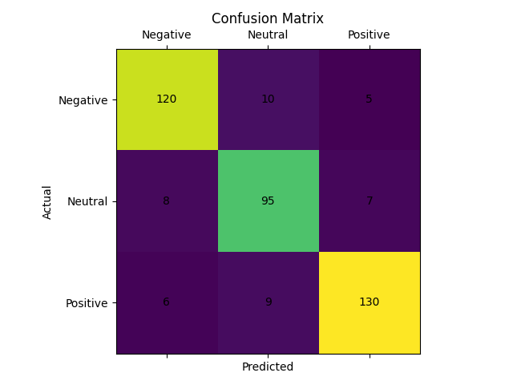
Model Evaluation :
Used Confusion Matrix to evaluate model performance
Compared actual vs predicted sentiments
High values on diagonal show correct predictions
Model performs well across all sentiment classes

Slide 19
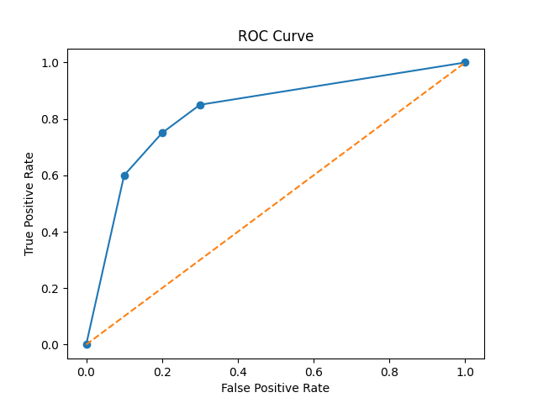
ROC curve shows model performance across thresholds
Compares True Positive Rate vs False Positive Rate
Curve closer to top-left indicates better performance
Model demonstrates good classification ability

Slide 20
Technical Observations:
TF-IDF effectively converted text into numerical features
SVM performed well for text classification tasks
Model handled high-dimensional data efficiently
Balanced performance observed across sentiment classes
Data preprocessing significantly improved model accuracy
Removal of noise and duplicates enhanced predictions
Model showed good generalization on test data

Slide 21
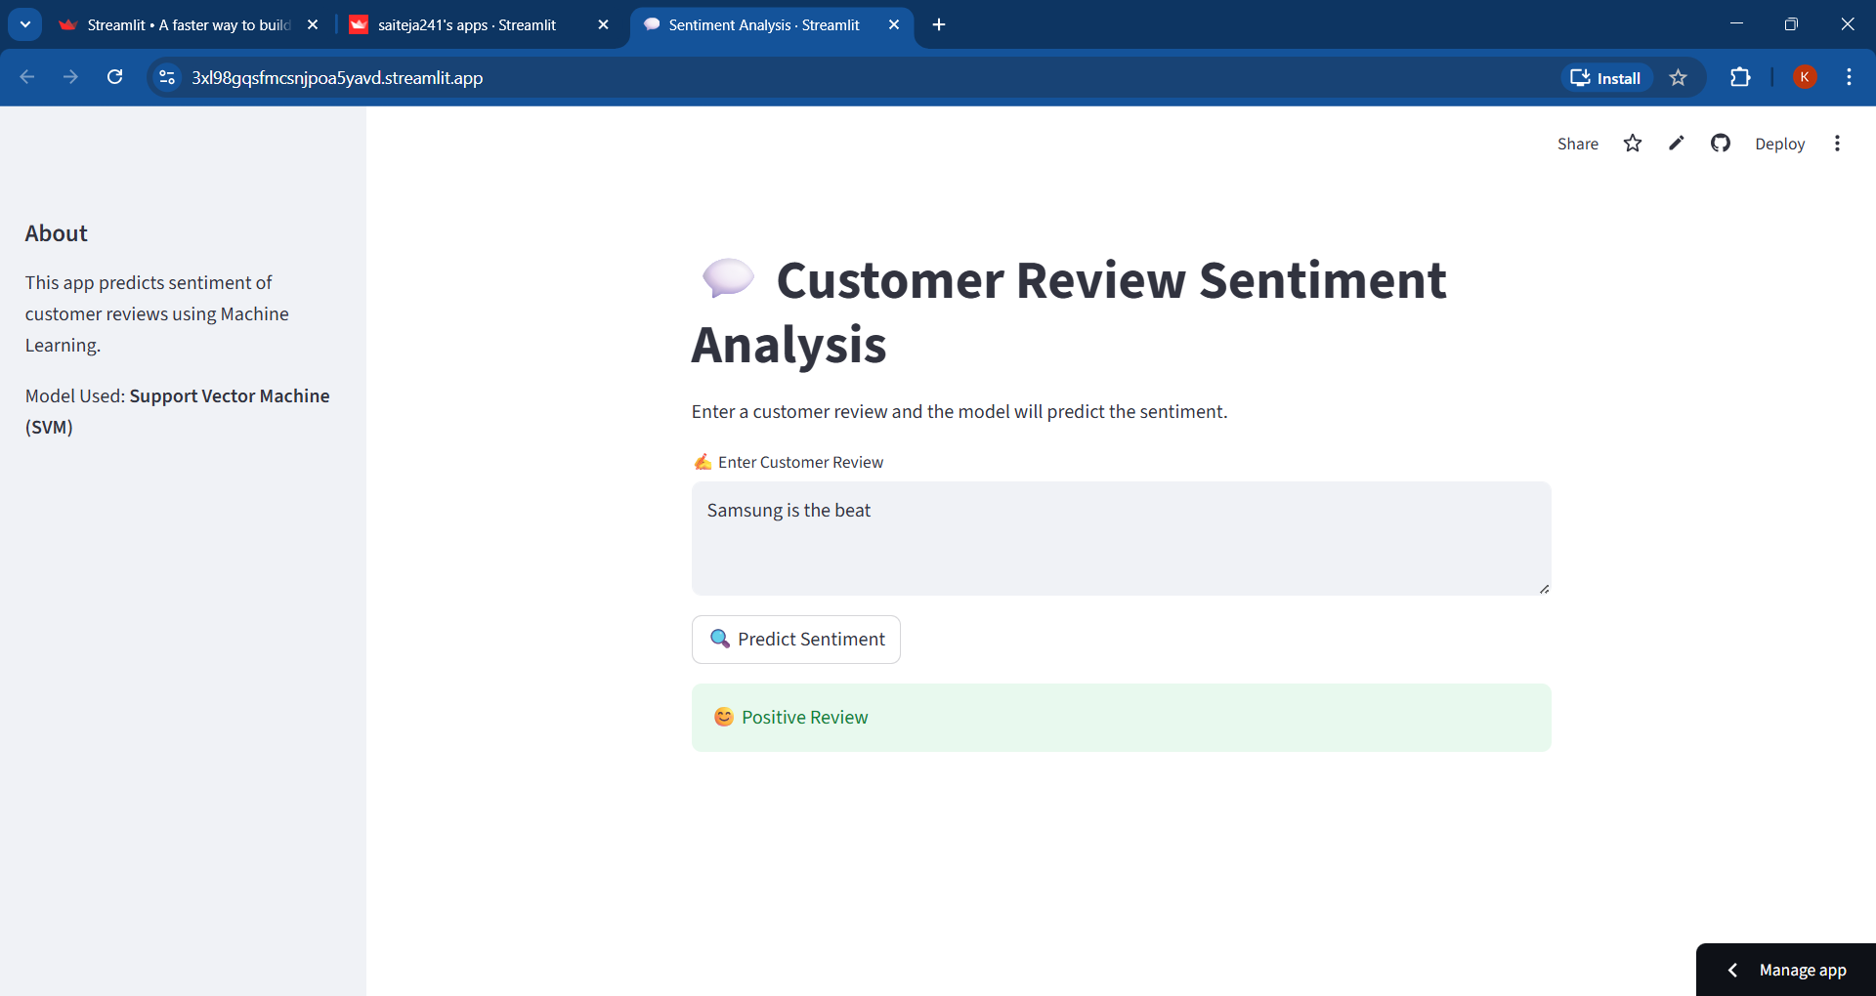
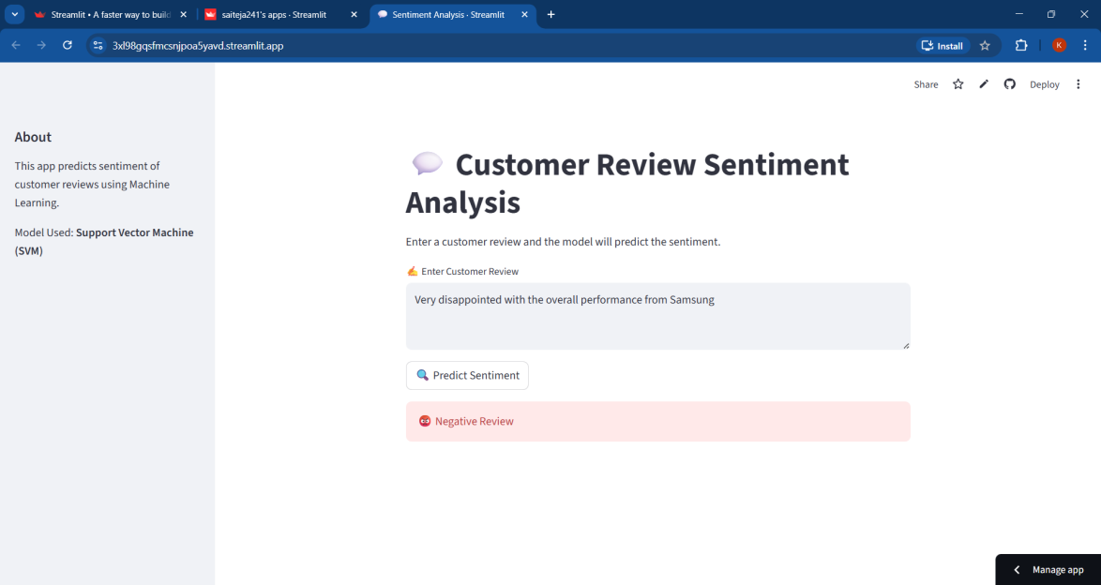
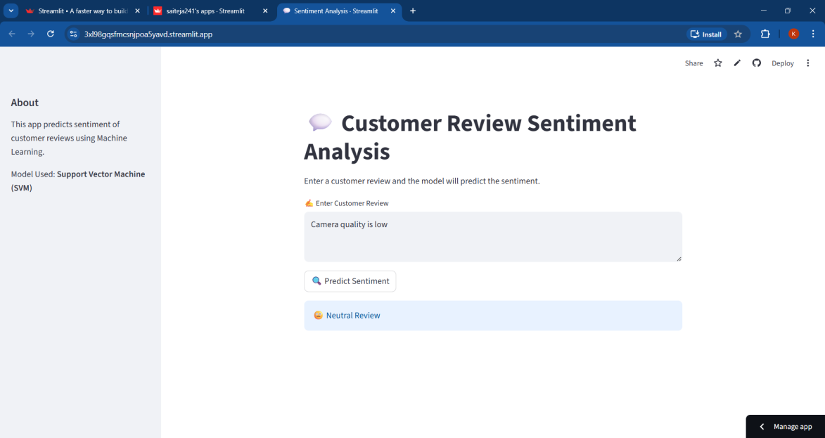
MODEL DEPLOYMENT:

Slide 22


Slide 23


Slide 24
Observations of Model Deployment
Application runs smoothly on Streamlit interface
Real-time sentiment prediction achieved
Fast response for user input
Model correctly classifies most reviews
User-friendly and easy to interact

Slide 25
CHALLENGES FACED DURING PROJECT
Data Quality Issues:
Presence of noisy and irrelevant reviews affected model learning
Inconsistent formatting required extensive cleaning
Short Text Problem
Many reviews were very short (e.g., “Good”, “Bad”)
Limited context made sentiment classification difficult
Feature Limitation
Important context like word order was not captured
Bag-of-words approach ignored sentence structure
Overfitting Risk
Some models performed well on training data but not on test data
Required careful validation and tuning
Hyperparameter Tuning
Finding optimal parameters for models like SVM and XGBoost was time-consuming
Required multiple iterations for better performance
Computational Cost:
Training multiple models increased time and resource usage
High-dimensional data slowed down processing

Slide 26
Conclusion
Successfully developed sentiment analysis system using NLP
SVM model provides accurate and consistent results
Data preprocessing improved overall performance
Deployed application enables real-time predictions
Useful for understanding customer feedback and decision-making

Slide 27
THANK YOU

